Slide 1
Coursera Case Study in R: Cyclistic Bikes
by Brian Truong
July 2022

Slide 2
Problem:
Solution:
The future success of the company relies on maximizing annual memberships
Market towards and convert casual riders to annual members

Slide 3
ANALYTICAL GOALS
HOW: Figure out how casual riders and annual members use Cyclistic differently
WHY: To market specifically towards casual riders to convert into annual members

Slide 4
ANALYTICAL GOALS
HOW: Figure out how casual riders and annual members use Cyclistic differently
WHY: To market specifically towards casual riders to convert into annual members

Slide 5
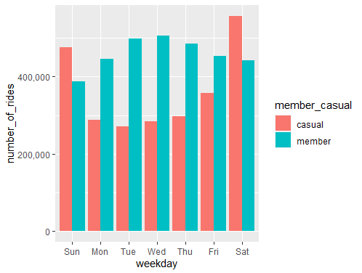
Weekday and Weekend Rides
We can speculate from this graph that members ride more on the weekdays and casuals more on the weekends.
Work commuters vs. Leisure/city-goers
*further research and analysis needed to confirm speculation

Slide 6
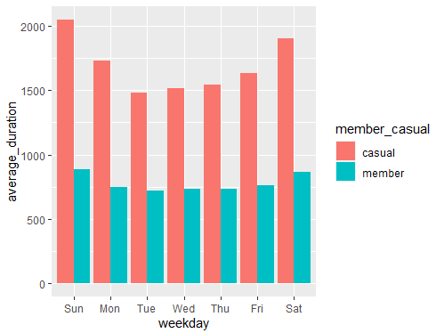
Duration of Rides
Speculating from the last graph and this one, commuters would have less ride times than city-goers.
Commuters traveling from A to B, city-goers using a bike as their means of transport around the city
*further research and analysis needed to confirm speculation

Slide 7
To convert casual riders to members, we would have to market towards riders using Cyclstic for leisurely pursuits, rather than commuting.

Slide 8
ANALYTICAL GOALS
HOW: Figure out how casual riders and annual members use Cyclistic differently
WHY: To market specifically towards casual riders to convert into annual members

Slide 9
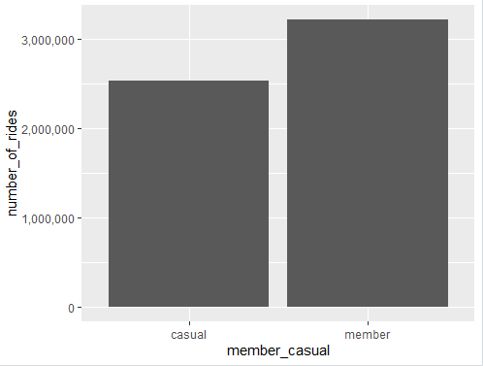
Number of Rides per Rider
Casuals have less number of rides compared to members, despite consistently longer ride times throughout the week and more use on the weekends

Slide 10
To convert casual riders to members, it may be in our best interest to create a new membership specifically marketed toward the current casual rider.

Slide 11
SUMMARY
HOW: Speculatively, casual riders use Cyclistic for more leisure and weekend riding around town compared to annual members
WHY: Creating a new membership that offers benefits outside of commuting by bike could help convert casual riders to members

Slide 12
Further Data Exploration for Casual Riders
What specific activities are casual riders using Cyclistic bikes for?
Is there a certain bike type or incentive we can invest in to attract more casual riders?

Slide 13
Thank You.

